Slide 1
UAV’s
Unmanned Aerial Vehicles

Slide 2
01
Introduction
05
Challenges
What are UAV’s & when did they become present in our world?
What are the challenges and some of the current concerns for UAV’s?
02
History of UAV’s
06
Designs UAV’s
How did the UAV’s come to existence?
How are the different designs and aspects of UAVs affecting the market?
CONTENT
03
Applications of UAV’s
07
Future of UAV’s
What are some of the potentials the UAV’s have for the future?
What are some of the most commen applications of UAV’s
04
Advantages
08
Conclusion
What are the advantages of UAV’s as compared to traditional machines?
Significance and impact of UAVs
2

Slide 3
INTRODUCTION
Unmanned Aerial Vehicles, or UAV’s, are aircraft that can be operated without a human pilot on board. They have been in development since the early 20th century, but it wasn’t until the 1990’s that they started to see widespread use. Today, UAV’s are used for variety of purposes and come in various shapes and sizes,
from small handheld units to large military-grade models. They are equipped with cameras, sensors, and other advanced technologies that allow them to capture data and perform a variety of tasks, but besides the military purposes and surveillance they are also used for scientific research and commercial photography.
3

Slide 4
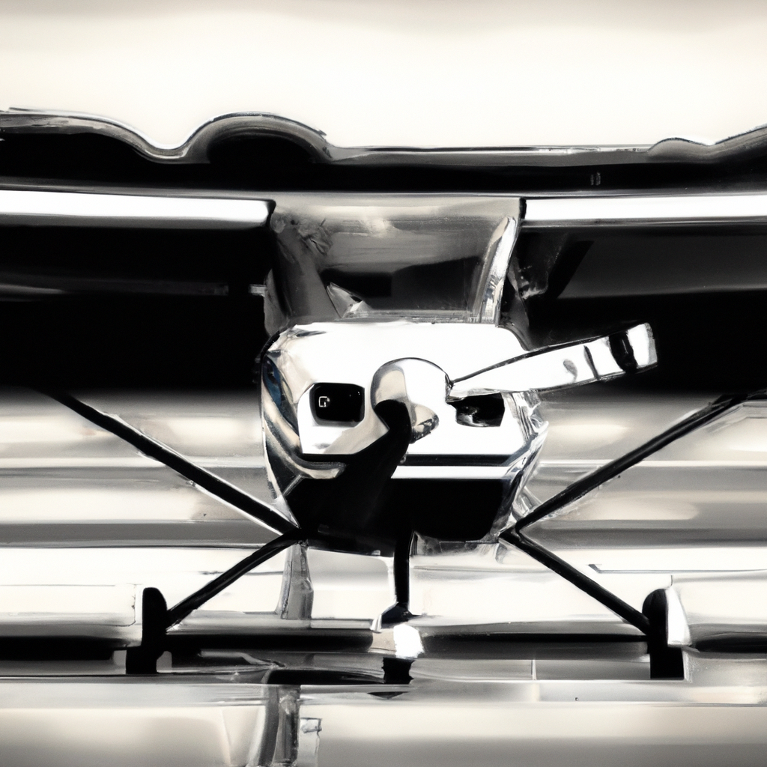
HISTORY of UAV’s
The first UAV was developed by the US military in 1917, but it was not until the 1960’s that UAV technology began to advance significantly.
During the Cold War, UAVs were primarily used for surveillance mission over enemy territory. In the 1990s, advances in technology led to the development of armed UAVs, which have been used extensively in the recent conflicts in Afghanistan and Iraq.
However, modern UAVs debuted as an important weapons system in the early 1980s, when the Israeli Defense Forces fitted small drones resembling large model airplanes with trainable television and infrared cameras and with target designators for laser-guided munitions, all downlinked to a control station.
4

Slide 5
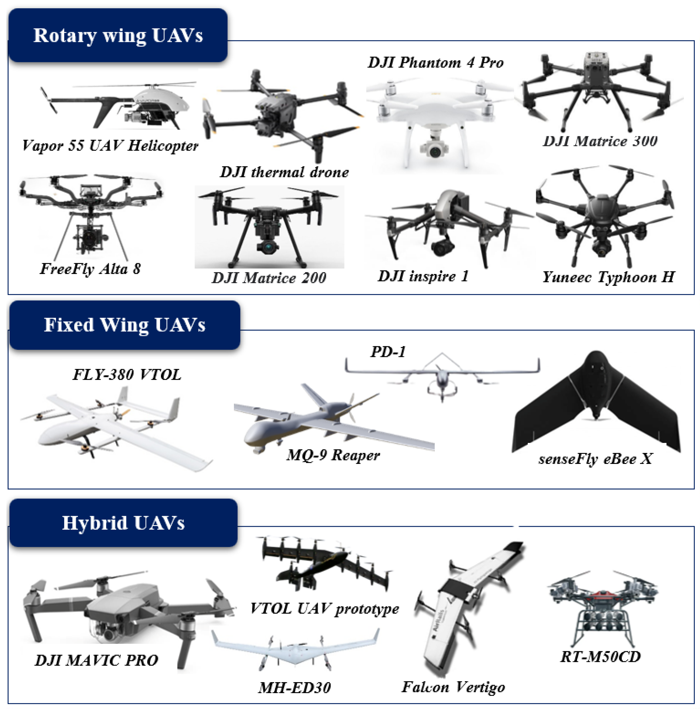
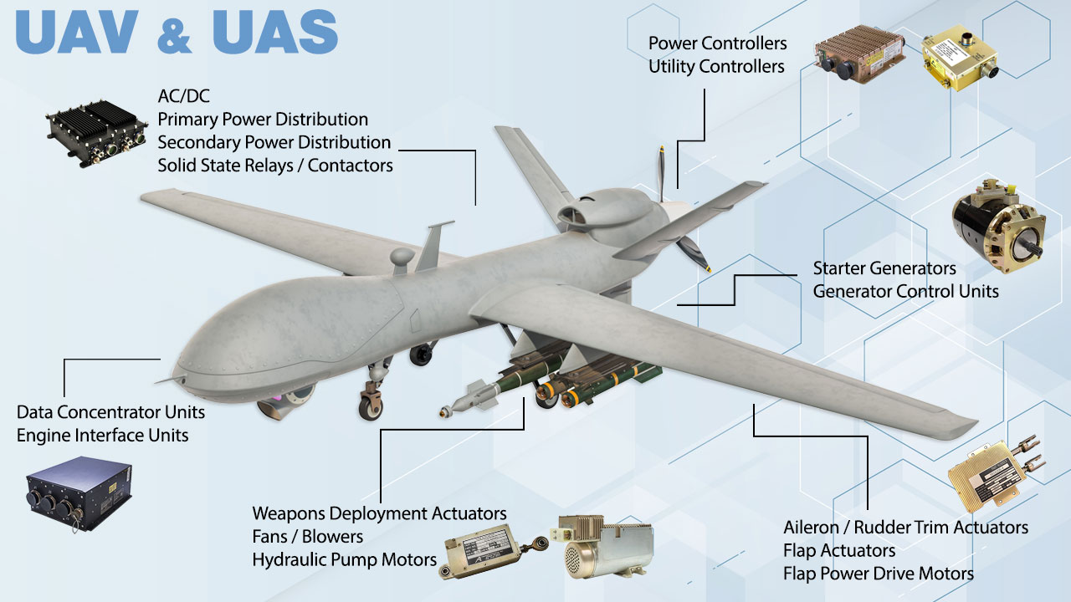
Structure & Appearance
5

Slide 6
CERTAIN SERVICES
Aerial Photography & Videography
Asset Inspection
Mapping and Surveying
Forensics
Search and Rescue
Aviation
Meteorology
6

Slide 7
APPLICATIONS OF UAVs
UAVs have a wide range of applications, from military operations to scientific and civilian use. In the military, UAVs are used for reconnaissance, surveillance and target acquisition. They can also be used for offensive purposes, such as carrying out airstrikes. What makes them suitable for that is the fact there is no one on board and in case it gets brought down, there are no human casualties.
In the civilian world, UAVs are used for variety of purposes, including aerial photography, surveying land, monitoring wildlife, inspecting infrastructure, meteorology and delivering goods. They are also used in search and rescue operations, as they can easily access hard-to-reach areas.
Overall, UAVs in various fields and are becoming increasingly important tools for businesses, governments, and individuals. As the technology continues to improve, we can expect to see even more innovative uses for UAVs in the future.
7

Slide 8
SERVICES OF UAVs
Aerial photography and videography: UAVs equipped with high-quality cameras can capture stunning aerial photos and videos that would be difficult or impossible to obtain from the ground. They can be used for real estate marketing, construction site monitoring, and landscape mapping, among other purposes.
Agriculture: UAVs can be used to monitor crop health and detect pests and diseases, which can help farmers make informed decisions about when and where to apply fertilizers and pesticides. They can also be used to gather data on soil moisture and temperature, plant height, and other agricultural parameters.
3. Search and rescue: UAVs equipped with thermal imaging cameras and other sensors can be used to locate missing persons or animals, as well as to assess damage after natural disasters.
4. Delivery services: Companies like Amazon and Google are exploring the use of UAVs for delivering packages to customers. This could potentially reduce delivery times and costs, especially in remote areas.
5. Infrastructure inspection: UAVs can be used to inspect bridges, power lines, pipelines, and other Infrastructure, reducing the need for manual inspections that can be dangerous and time- consuming.
8

Slide 9
Advantages of UAVs
There are several advantages to using UAVs over traditional aircraft. For one, they are much cheaper to operate, as they do not require a human pilot. This makes them ideal for tasks that are too dangerous or difficult for humans to perform, such as exploring hazardous environments like volcanoes or nuclear power plants.
1
UAVs are also more versatile than traditional aircraft, as they can be programmed to perform specific tasks and can fly in areas where traditional aircraft cannot. Additionally, they are more environmentally friendly, as they produce fewer emissions than traditional aircraft.
2
Further, they are also highly maneuverable and can be equipped with a variety of sensors and cameras, making them useful for a wide range of applications.
3
9

Slide 10
Challenges of UAVs
Despite their many advantages, UAVs also face several challenges. One of the biggest challenges is safety, as UAVs can pose a risk to other aircraft and people on the ground if they malfunction or lose control. Regulations around the use of UAVs are still evolving, and there is concern about privacy and security issues related to their use.
1
Another challenge is the limited battery life of most UAVs, which limits their flight time and range. This can make it difficult to perform certain tasks, such as long-distance surveillance or delivery of goods. Finally, there is a shortage of skilled operators who are trained to operate UAVs safely and effectively.
2
Further disadvantage of UAVs would be that they can be expensive to develop and maintain, which limits their accessibility to smaller organizations.
Additionally, there are concerns about privacy and civil liberties when it comes to the use of UAVs for surveillance purposes.
3
10

Slide 11
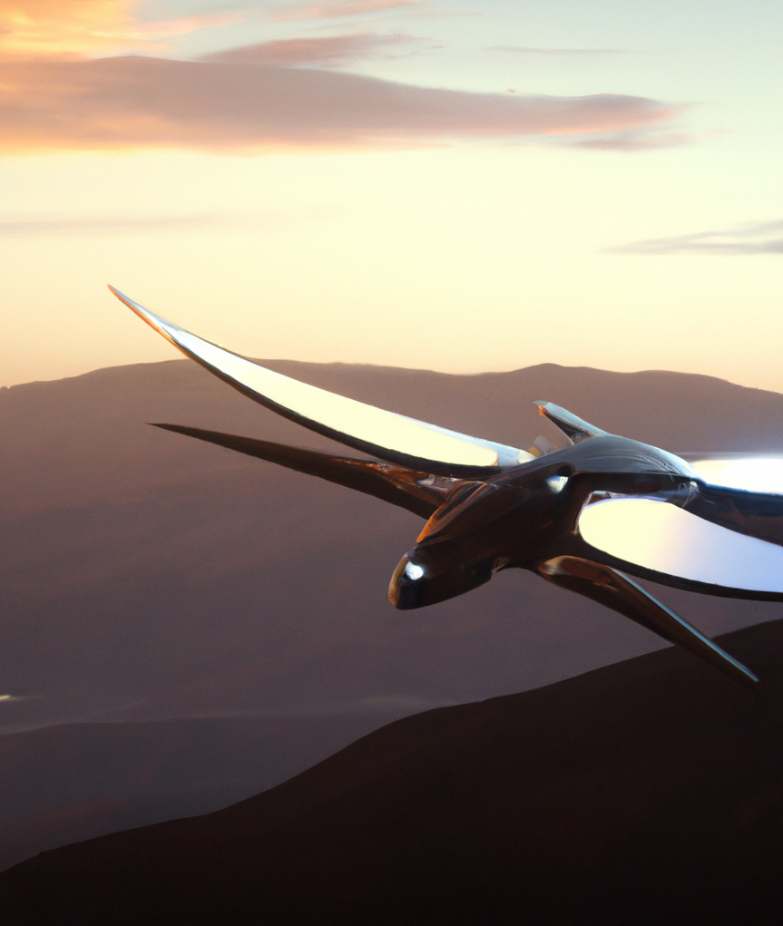
DESIGN OF UAVs
The frame and design of UAVs are crucial factors that determine their capabilities and applications. The design must balance weight, aerodynamics, and structural integrity to achieve optimal performance.
Fixed-wing UAVs have a traditional airplane-like design with wings that generate lift and propulsion from a motor. They are ideal for long-range surveillance and mapping missions due to their endurance and stability.
The frame of fixed-wing UAVs is typically made of lightweight materials such as carbon fiber or aluminum. The wingspan and wing loading determine the maximum payload capacity and flight time.
11

Slide 12
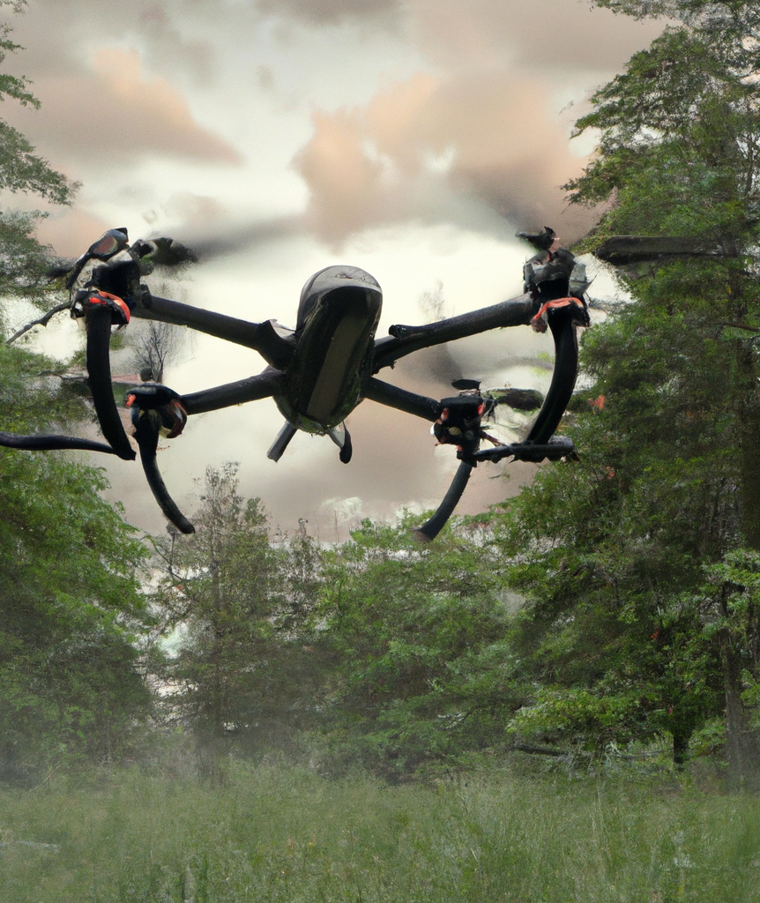
MULTIROTOR UAVs
Multirotor UAVs have a unique design with multiple rotors that provide lift and control. They are highly maneuverable and can hover in place, making them ideal for close-range inspections and aerial photography.
The frame of multirotor UAVs is typically made of lightweight materials such as plastic or composite materials. The number and arrangement of rotors affect the stability and agility of the drone.
12

Slide 13
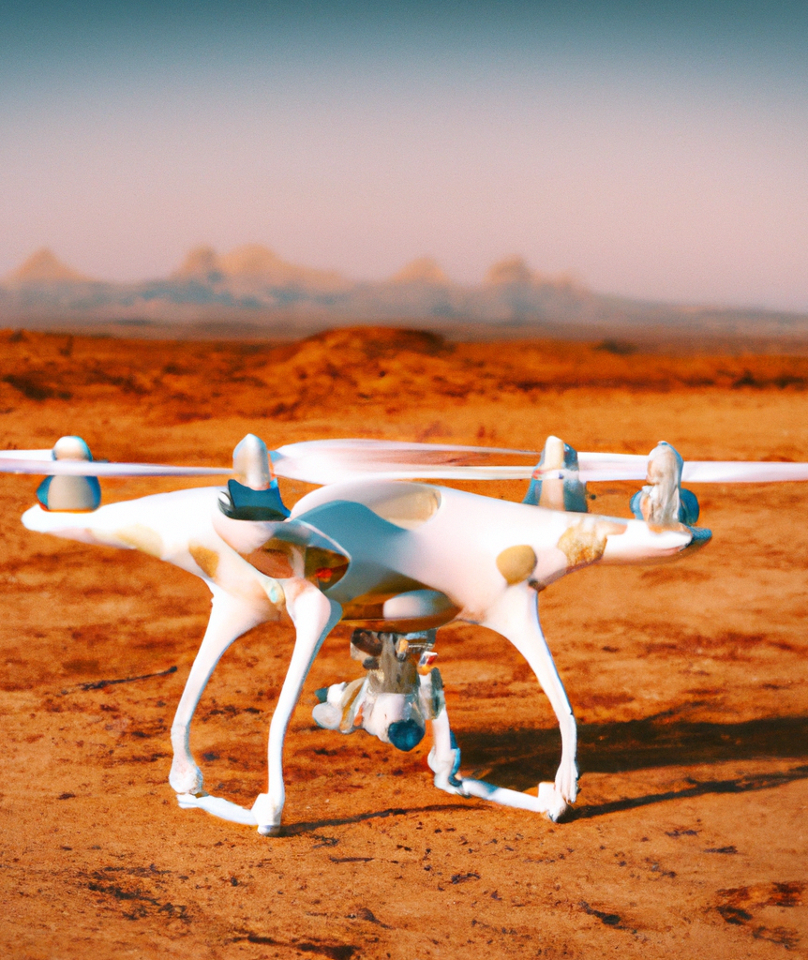
HYBRID UAVs
Hybrid UAVs combine the advantages of fixed-wing and multirotor designs. They can take off and land vertically like a helicopter and transition to forward flight like an airplane. This allows them to cover large distances quickly and efficiently.
The frame of hybrid UAVs is more complex than other types, with additional motors and mechanisms for transitioning between flight modes. The design must also account for the weight and balance of the components.
13

Slide 14
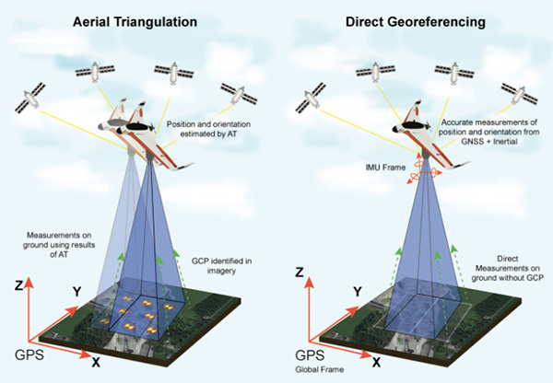
NAVIGATION SYSTEM
There are several types of navigation software used in UAVs, including GPS, INS, and computer vision systems.
GPS relies on satellite signals to determine the drone's location, while INS uses internal sensors to track movement. Computer vision systems use cameras to identify and avoid obstacles.
The frame of hybrid UAVs is more complex than other types, with additional motors and mechanisms for transitioning between flight modes. The design must also account for the weight and balance of the components.
Despite advances in technology, there are still challenges that must be overcome in UAV navigation software.
One challenge is the need for real-time processing of large amounts of data, which can strain the drone's hardware. Another challenge is the ability to operate in complex environments, such as urban areas or indoors.
14

Slide 15
PRICES OF UAVs
above $3000
$300 to $500
$600 to $1000
High-end professional drones that are used in more particular applications such as research and military purpose
Mid-level consumer drones, can be used for professional work such as surveillance and mapping
Beginner entry-level camera drones, that can me used commercially and for education.
Entry-level
Mid-level
Professional
15

Slide 16
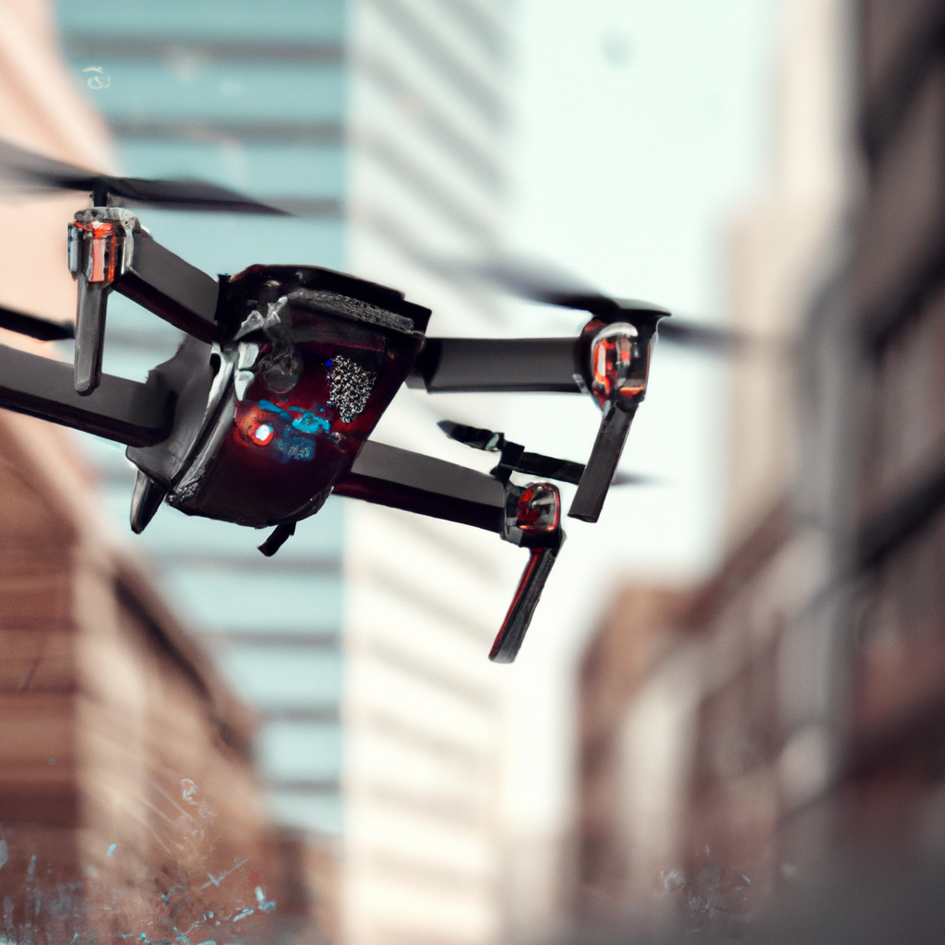
Future of UAVs
The future of UAVs looks bright, as advancements in technology continue to improve their capabilities and reduce their costs. There is potential for UAVs to revolutionize industries such as agriculture, transportation, and logistics, as they can provide real-time data and insights that were previously impossible to obtain.
As regulations around the use of UAVs become clearer, we can expect to see more widespread adoption of this technology. However, there are also concerns about the impact of UAVs on jobs and the economy, as they may replace human workers in certain industries.
16

Slide 17
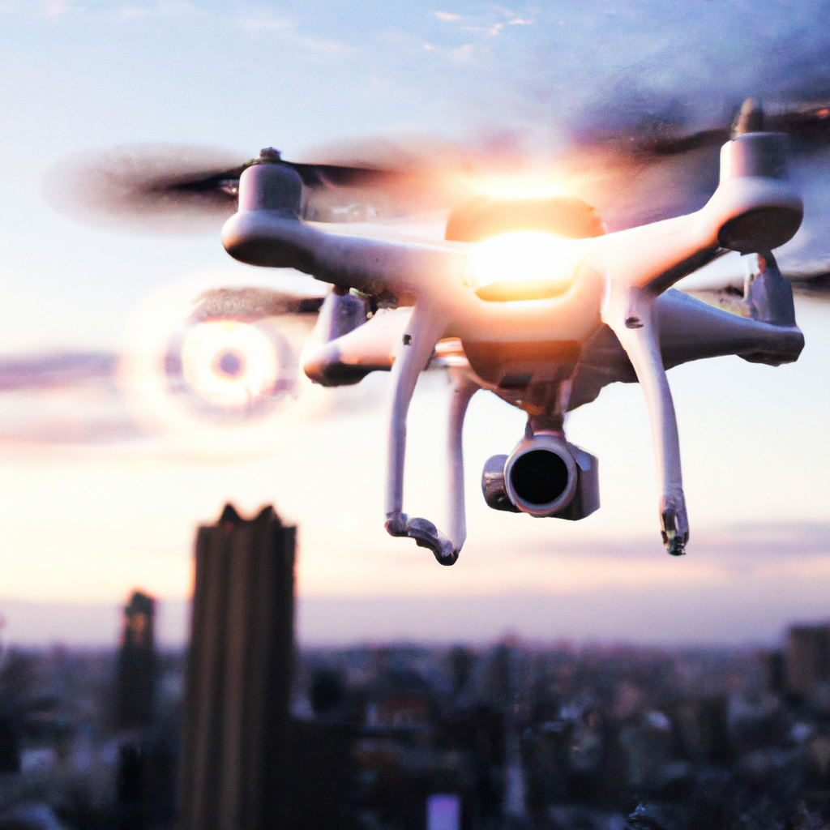
CONCLUSION
Unmanned Aerial Vehicles have already made a significant impact in various industries, and their potential uses are only just beginning to be explored. As technology continues to advance, UAVs will become even more capable and affordable, making them accessible to a wider range of users.
However, it is important to address the challenges associated with UAVs, particularly in regards to safety and regulation. By doing so, we can ensure that this technology is used responsibly and for the benefit of society as a whole.
17

